Slide 1


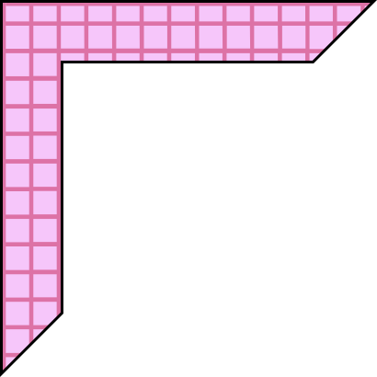

EMPOWERING PARLYSIS WITH EYE CONTROLLED TECHNOLOGY
TEAM: TECHMYSTICS
TEAM MEMBERS:
THAMEEMUL ANSARI
S. ASIFA
A. SAVITHA SREE
DIVERSITY AND INCLUSION

Slide 2




OBJECTIVE
Our product is a revolutionary solution designed to empower paralyzed individuals with an unparalleled level of independence in the digital realm. By seamlessly integrating advanced eye-tracking software and image recognition, our innovation enables precise and intuitive control over computers and technology using only eye movements.
The main objective of this project is to enable users to type text using their eyes' movement. By detecting and interpreting eye movements, the system enables users to select predefined actions or type on a virtual keyboard, triggering custom voice alerts to notify caregivers or nearby individuals of their needs.

Slide 3


TECHNOLOGIES USED
OPENCV
SHAPE_PREDICTOR_68_FACE_LANDMARKS.DAT
DLIB
Math (hypot)
PYGLET
Numpy

Slide 4
FLOW OF THE PROJECT
Program starts by displaying a Menu with two options -Left and Right.
The user is prompted to look towards either the left or right side of the screen to select the corresponding keyboard layout.
The user interacts by blinking to select a key.
The program shows a bar when the user blinks. If the bar fills up within a set time, it recognizes the blink as intentional and performs an action. This distinguishes deliberate blinks used for interaction from unintentional ones.
The selected letter gets typed in the screen.

Slide 5
FUTURE SCOPE
Our project aims to extend its impact by empowering paralyzed individuals with autonomous control over domestic appliances. By leveraging the technology developed for eye-controlled input, we envision a future where individuals with paralysis can seamlessly interact with their environment, including controlling appliances such as fans and lights, with intuitive eye movements and blinks. This advancement holds the promise of enhancing independence and quality of life for individuals facing mobility challenges, offering them greater autonomy and freedom within their homes.

Slide 6
Functions used:
draw_letters(letter_index, text, letter_light): This function is responsible for drawing the letters on the virtual keyboard. It takes three parameters:
letter_index: The index of the letter on the keyboard.
text: The actual letter to be displayed.
letter_light: A boolean indicating whether the letter should be highlighted or not. Based on this, the function draws the letter in white or grey.
draw_menu(): This function draws the menu for selecting between the left and right virtual keyboards.
midpoint(p1, p2): This function calculates the midpoint between two points (p1 and p2). It's used in calculating the centre of the eye contours.

Slide 7
Functions used:
get_blinking_ratio(eye_points, facial_landmarks): This function calculates the blinking ratio of the eyes. It takes two parameters:
eye_points: A list of indices corresponding to the points around the eyes.
facial_landmarks: The detected facial landmarks. It calculates the ratio of horizontal to vertical distance between certain points around the eyes to detect blinking.
eyes_contour_points(facial_landmarks): This function extracts the contour points for both left and right eyes from the detected facial landmarks.
get_gaze_ratio(eye_points, facial_landmarks): This function calculates the gaze ratio of the eyes. It takes the same parameters as get_blinking_ratio. It calculates the ratio of white pixels on the left side of the eye to those on the right side to determine the direction of gaze.

Slide 8
Case of Accidental clicks

Slide 9
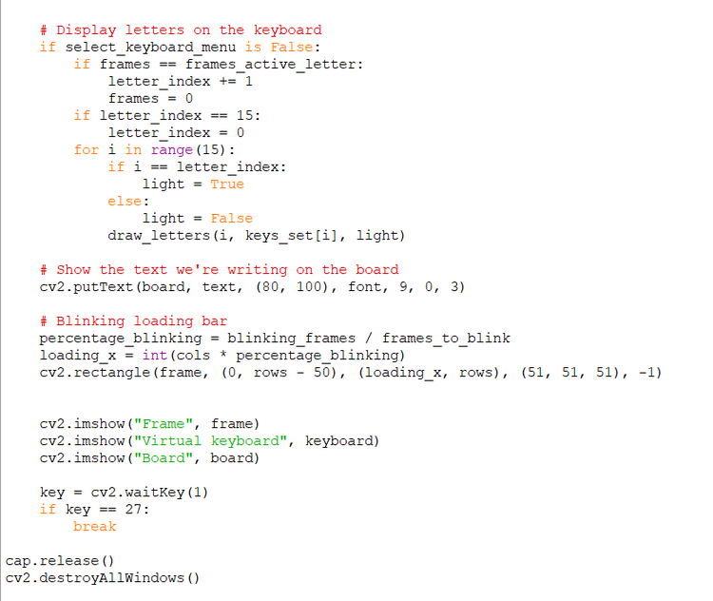
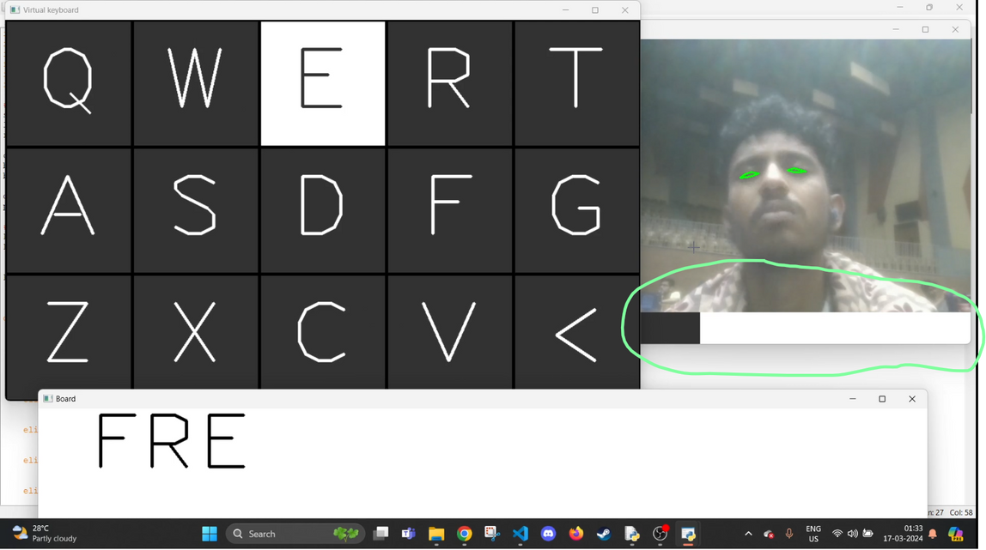
We do know an average human blinks around between 14,400 and 19,200 times a day. so we added a blinking loading bar. You need to blink until the bar loads up to full or the letter which you wanted to type will not show up.

Slide 10

LINKS
To view the code used in this program follow my GitHub link
https://github.com/Thameemking/DevHouse-24-Techmystics/tree/main
To see the working model of the project please visit my youtube channel
https://youtu.be/BvIeglyjRBY

